Slide 1
C29PE Economics for Professionals
Week 3 –
Part 1: Utility, Demand and Risk
Sloman et al., 2023, Chapter 6
Part 2: Costs of Production, Revenue and Profit
Sloman et al., 2023, Chapter 9

Slide 2
Session Aims:
To define concepts of marginal utility and consumer surplus
To explore the economics of risk and uncertainty
To learn how a business can combine its inputs in the most efficient way
To examine how costs vary with output in both the short run and the long run

Slide 3
References
Sloman et al (2023)
  Chapter 6.1 – 6.2
  Boxes 6.1 – 6.3
  Chapter 9.1 – 9.5
  Boxes 9.1, 9.3 & 9.4
Important!
  The PowerPoint slide deck for Week 3 lecture provides a guideline of the topics you need to know. However, the materials in the slide deck are insufficient if you wish to excel in the course
  To do well, please do not forget to read the relevant sections of the core textbook
  Please also ensure that you follow economics news regularly as these sources could be used as examples to supplement your answers during assessments

Slide 4
Part 1

Slide 5
Demand and utility
Why consume? To be satisfied
Measuring satisfaction – utility
Total utility vs marginal utility
  Marginal utility is diminishing (why?)
  Marginal utility curve is coincident with demand curve
  Area below marginal utility and above price = consumer surplus (‘profit’ or net gains from consuming something)

Slide 6
Risk and uncertainty
Biggest uncertainty in the last two years: Covid 19 and post-Covid recovery
  Biggest uncertainty facing humanity: climate change
In the rest of this course, events are certain
  Buy goods and obtain certain utility – never surprised
  Firm knows market prices, market demand curve, cost curves
    Certain about how to choose output to maximise profits
In life, events are almost all uncertain
  Grade for this course; degree classification
Some events involve risk: specific form of uncertainty
  Assign probabilities to every event: when buying a lottery ticket
Some people, in some situations embrace risk, uncertainty
  Buying a lottery ticket is a simple gamble
  Frequent cigarette smoking has very uncertain consequences

Slide 7
Example of a gamble
Outcome determined by roll of die
  Six faces, assume each face equally likely to come up
    In infinite number of die throws, each comes up 1/6 of the time
    So probability of each outcome is 1/6
  Winnings with each face
  Expected winnings E[Winnings] = (1 + 3 + 6 + 10 + 15)/6 = 35/6
Number | 1 | 2 | 3 | 4 | 5 | 6
Winnings | 0 | 1 | 3 | 6 | 10 | 15
Winnings
Probability

Slide 8
Attitudes towards any risk
Risk neutral
  Choose the option with the highest expected value
Risk averse
  Certainty equivalent of a gamble is less than expected value
    Don’t choose a gamble with the same expected value as the certain pay-off
    Might choose a gamble if its expected value is greater than the certain pay-off
Risk loving
  Certainty equivalent of a gamble is greater than expected value
    Choose the gamble if it has the same expected value as the certain pay-off
    Even choose some gambles with lower expected value than a certain pay-off
Notes:
4

Slide 9
The marginal utility of income
Would you prefer having more income to less income?
  Do you think that you would put as much value on each succeeding 1% increase in your income?
    Answer, ‘yes’, then ‘no,’ and you have a diminishing marginal utility of income
    Total utility of income curve slopes up, but becomes flatter
  We argue that this is consistent with people being risk-averse
    Example: initial income £10,000
    Pay stake of £5,000
    With probability 0.5 win £10,000; with probability 0.5 win 0
Notes:
5

Slide 10
Decreasing marginal utility
Total utility
TU
b
100
Total utility curve slopes up when marginal utility is greater than zero
Diminishing marginal utility when total utility curve becomes flatter as income increases
Total utility of an income of £10,000 is 100
Income (£)
0
10 000

Slide 11
Total utility and the gamble
Total utility
After the gamble
  with probability 0.5, income is 5,000; and utility is 70
  And with probability 0.5, income is 15,000; and utility is 116
  Expected income is 10,000
  (0.5*5,000 + 0.5*15,000)
  Expected utility is 93
  (0.5*70 + 0.5*116)
c
116
TU
e
93
a
70
Income (£)
0
5000
10 000
15 000

Slide 12
The risk premium
Total utility
In gamble, with probability 0.5, income is 5,000; with probability 0.5, income is 15,000
  Expected income 10,000
  Expected utility 93
Certainty equivalent 8,000
  Total utility 93
Willing to sell participation in gamble for 8,000
Risk premium, 2,000: (expected wealth less certainty equivalent)
c
116
TU
b
100
d
e
93
a
70
Risk Premium
Income (£)
0
5000
8000
10 000
15 000

Slide 13
What we do
Continue thinking about risk – turn attention to insurance
  Discuss nature of insurance contract: premium and payouts
  Consider the importance of individual risk pricing
    Introduce adverse selection as problem in which low risk consumers will not buy insurance
    Discuss signalling and screening as potential remedies
  Also note problem of moral hazard – as behaviour changes because of risk transfer

Slide 14
The nature of insurance
Risk averse people do not want to bear risks
  Willing to pay any sum up to their risk premium to avoid them
  Insurance contracts allow us to transfer cost of risks to insurance company
Types of insurance
  Flood insurance for houses
  Insurance against damage in accident for car (and liability for injury)
  Travel insurance in event of cancellation or loss while on holiday
  Health insurance allowing treatment in event of illness or injury
Simple contract
  A good state of the world, and a bad state (or more)
  Pay insurance premium before knowing state
    Insurer pays loss incurred if bad state occurs
Notes:
5

Slide 15
The adverse selection problem
Drivers least likely to have accidents stop buying insurance
  Insurance companies have to raise their premiums
  More drivers stop buying insurance
In some economic models, markets collapse completely
  Whatever happens, drivers with the highest risk of accident carry on taking out insurance
  Low risk drivers will either
    Not take out insurance at all
    Buy partial instead of full insurance (high deductible/excess in policy)
All this assumes that it is impossible to distinguish members of the risk class, and match policies to characteristics

Slide 16
Resolving adverse selection
Signalling: demonstrate that you have desirable characteristics
  Education: is this a signal of high productivity?
    Suppose that getting a degree involves doing many difficult tasks, all of which are essentially useless
    But only highly productive people can perform them
    Then having a degree is informative to employers
Screening – the insurance solution
  A low risk driver may be willing to share costs of repairs with the insurer
    Pays first £250 or £500 of any claim;
    High risk driver will not do this
    So willingness to share costs informative for insurer
Notes:
5

Slide 17
Moral hazard
Once insured, people may act with less care
  Probability of accident increases; insurer faces loss
Define moral hazard
  Effect of a contract transferring risk leading to a change in behaviour of one or other party, against the interests of the other party
    Improving workers’ rights may cause them to work less hard
    Setting rewards for teams may mean that members of the team ‘easy ride’
    Banks with deposit guarantee may make excessively risky loans –and fail
Notes:
5

Slide 18
Addressing moral hazard
Monitoring behaviour
  Insurers use loss adjusters
  Aim is to identify whether claim is legitimate – some people deliberately have car accidents to claim on insurance policy
    But this can be very costly
Redesign the contract
  My contract allows me generous sickness absence
    University has policy for ‘managing attendance’
      Requires all staff to submit medical certification after 4 days
      Meet occupational health consultants to support return to work
    Intention is to reduce abuse of entitlements

Slide 19
Part 2

Slide 20
Costs of Production, Revenue and Profit
‘Most firms raising prices in 'cost-of-doing-business crisis’’
‘Three quarters of firms to put up prices as they face soaring wage and energy costs’
‘Companies Push Prices Higher, Protecting Profits but Adding to Inflation’
‘Big business is in for a rough earnings season – companies face falling revenues and rising costs’
‘Where on Earth is big oil spending its $150bn profit bonanza’
https://www.cips.org/supply-management/news/2022/february/most-firms-raising-prices-in-cost-of-doing-business-crisis/
https://news.sky.com/story/three-quarters-of-firms-to-put-up-prices-as-they-face-soaring-wage-and-energy-costs-12537690
https://www.nytimes.com/2023/05/30/business/economy/inflation-companies-profits-higher-prices.html
https://www.economist.com/business/2023/01/22/big-business-is-in-for-a-rough-earnings-season
https://www.economist.com/business/2023/02/06/where-on-earth-is-big-oil-spending-its-150bn-profit-bonanza

Slide 21
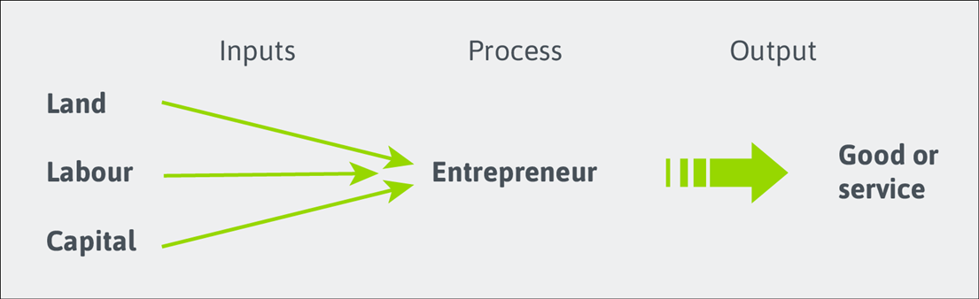
Production in the Short Run
Production functions (show the relationship between inputs and output)
The output of the firm is known as the TPP = total physical product
TPP over a given period is a function of (i.e., depends on) the quantity of factors of production employed
Increasing the quantity of inputs or improving the productivity of them can increase output.
What is productivity? (youtube.com)
Notes:
2

Slide 22
Production in the Short Run
Distinction between the short run and the long run
The short run is a period during which at least one factor of production is fixed.
The long run is a period long enough for all factors to be varied.
The actual length of the short run will differ from firm to firm – it is not a fixed period.
The Law of Diminishing Returns - each extra unit of the variable factor will produce less additional output than the previous unit.
Occurs in the short run when increasing amounts of a variable factor are used with a given amount of fixed factor
Simple example - assume just two factors - land (fixed) and labour (variable). Output per period can only be increased by increasing the number of workers. But imagine what would happen as more and more workers crowded on to a fixed area of land.
Notes:
2

Slide 23
Production in the Short Run
Example of production in the short run – a farm with fixed land and variable labour (farm workers).
With nobody working on the land, output (Total Physical Product) = 0.
With one or two workers efficiency is low.
With more workers - they can work as a team, each doing a specialist job and becoming more productive at it.
After a certain point, diminishing marginal returns set in: output rises less and less rapidly, and the TPP curve correspondingly becomes less steeply sloped.
Also illustrated by a production function are:
Average physical product (APP) – the output (TPP) per unit of the variable factor, for e.g., output of wheat per worker.
Marginal physical product (MPP) – the extra output (change in TPP) produced by employing one more unit of the variable factor.
Notes:
2

Slide 24
Wheat production per year from a particular farm
d
TPP
Maximum
output
b
Tonnes of wheat per year
Diminishing
returns
set in here
Number of
farm workers (L)
b
Activity: Discuss with a partner how many farm workers you would employ?
c
Tonnes of wheat per year
APP
d
Number of
farm workers (L)
MPP

Slide 25
Costs in the Short run
A firm’s cost of production will depend on the factors of production it uses, specifically:
The Productivity of Factors
  The greater their physical productivity, the smaller will be the quantity of factors needed to produce a given level of output and, hence, the lower will be the cost of that output.
  There is a direct link between TPP, APP and MPP and the costs of production.
  Prosperity Unlocked – How can Scotland unlock its potential and solve the productivity puzzle? - The Productivity Institute
The Price of Factors
  The higher their price, the higher will be the costs of production.
  In the SR, some factors are fixed in supply, for e.g., whether the firm produces a little or a lot, its rent will not change.
  The costs of variable factors, however, does vary with output. The cost of raw materials is a variable cost. The more that is produced, the more raw materials are needed and the higher is their total cost.
Notes:
9

Slide 26
Total costs for firm X
With zero output, no variable factors will be used. Total variable costs will increase as output increases (as more factors of production are needed).
TC
Total cost (TC = TFC + TVC)
TVC
Output
(Q)
0
1
2
3
4
5
6
7
TFC
(£)
12
12
12
12
12
12
12
12
TVC
(£)
0
10
16
21
28
40
60
91
TC
(£)
12
22
28
33
40
52
72
103
Diminishing marginal returns
set in here
TFC
Total fixed costs do not vary with output, so TFC is shown as a horizontal straight line.

Slide 27
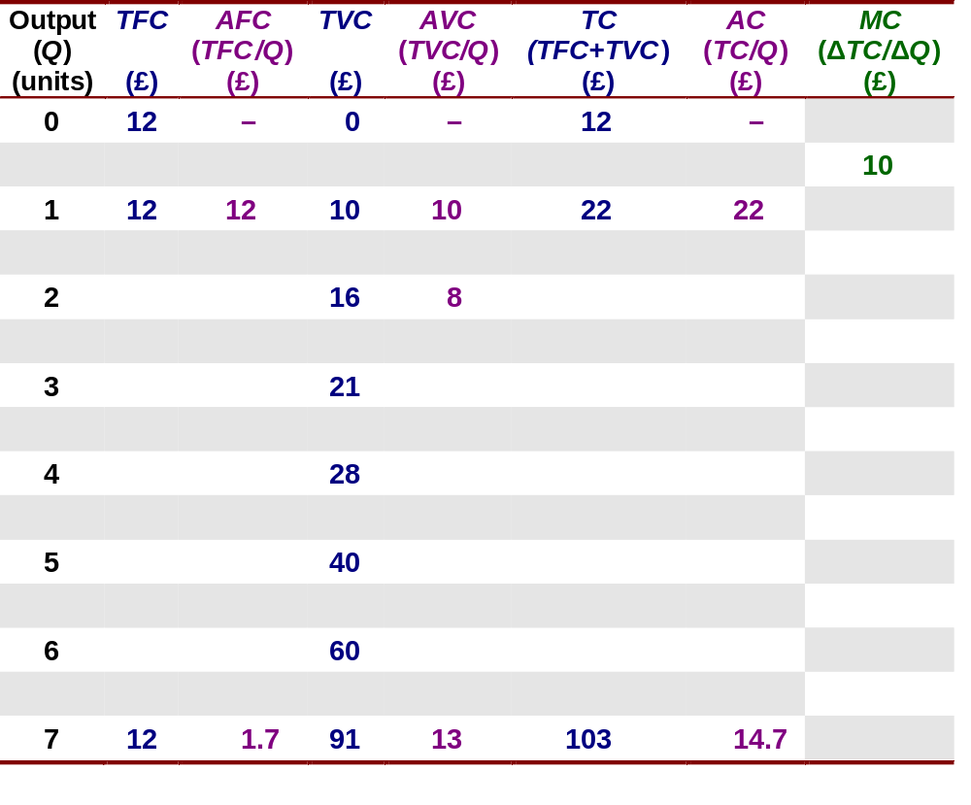
Total, average and marginal cost for firm X
Activity – complete as much of the table as you can.

Slide 28
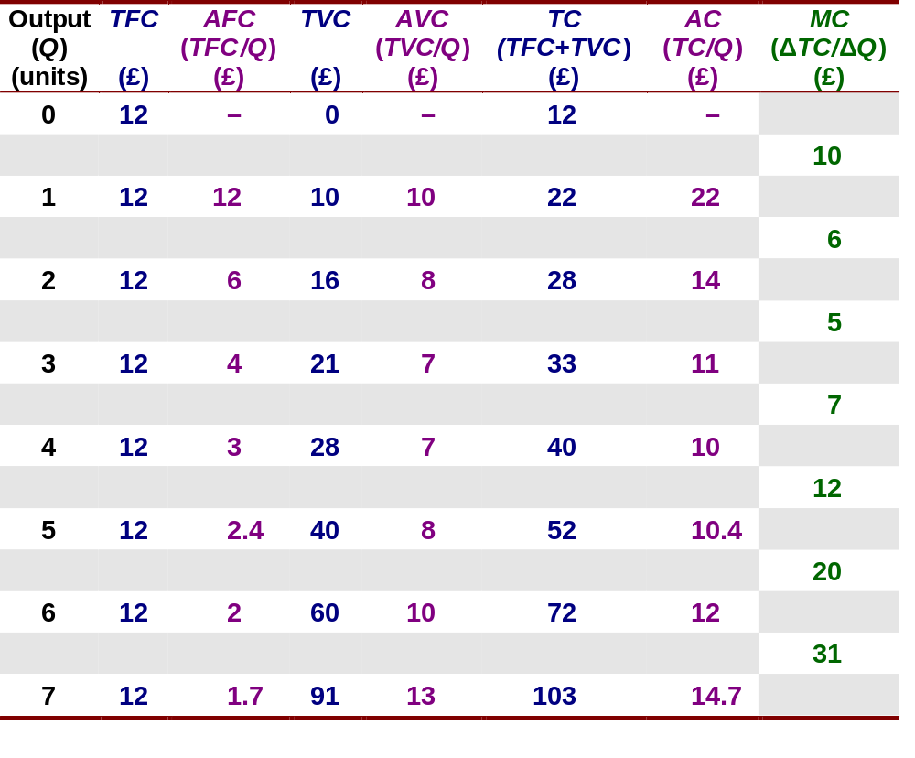
Total, average and marginal cost for firm X

Slide 29
Average and marginal costs (short run)
If MPP increases initially (due to specialisation, etc) and then falls (due to the law of diminishing returns), the cost of producing each additional unit of output will fall initially and then rise.
The AC curve is simply the vertical sum of the AFC and AVC curves.
Note that, as AFC falls, the gap between AVC and AC narrows
MC
AC
AVC
The shape of the AVC curve depends on the shape of the APP curve. As the average product of workers rises, the average labour cost per unit of output (the AVC) falls (up to point y). Thereafter, as APP falls, AVC must rise.
Costs (£)
z
y
x
AFC
Output (Q)
AFC falls continuously as output rises, since total fixed costs are being spread over a greater and greater output

Slide 30
Costs in the Short run
  Relationship between average and marginal cost – important to firm decision-making
  Activity:
    If the first unit of output costs £5 to produce and a second unit costs £4 to produce, should the firm produce the second unit?
    If a third unit costs £6 to produce, should the firm produce the third unit?
Notes:
10

Slide 31
Costs in the Short run
  Relationship between average and marginal cost – important to firm decision-making
  If the cost of additional units of output is less than the average, their production must pull the average cost down.
  Simple example:
    If one unit of output costs £5 to produce, TC = £5 and AC = £5
    If a second unit costs £4 to produce, MC = £4
    At this level of output MC < AC (£4 < £5)
    The result is that AC falls from £5 to £4.50 [(£5 + £4) / 2]
    If a third unit costs £6 to produce, MC now = £6
    At this level of output MC > AC (£6 > £4.50)
    The result is that AC increases from £4.50 to £5 [(£5 + £4 + £6) / 2]
Notes:
10

Slide 32
Production in the Long run
All factors of production are variable in the long run - there is time for the firm to build a new factory, to install new machines, to use different techniques of production, etc.
If a firm were to double all its inputs – something it could do only in the long run – would this cause its output to double? That depends on the returns to scale:
  Constant returns to scale – a given percentage increase in inputs leads to the same percentage increase in output
  Increasing returns to scale – a given percentage increase in inputs leads to a larger percentage increase in output
  Decreasing returns to scale – a given percentage of inputs leads to a smaller percentage increase in output
‘To scale’ means that all inputs increase by the same proportion. Decreasing returns to scale are, therefore, quite different from diminishing marginal returns (where only the variable factor increases)
Notes:
4

Slide 33
Production in the Long run
Economies of scale
  The concept of increasing returns to scale is closely linked to that of economies of scale.
  A firm experiences economies of scale if costs per unit of output fall as the scale of production increases.
  https://www.youtube.com/watch?v=B5ka9OE6cvU
Notes:
5

Slide 34
Production in the Long run – Reasons for Economies of Scale
  Specialisation and division of labour – simple, repetitive jobs allow for greater efficiency
  Indivisibilities – some inputs, like machinery, are of a minimum size for e.g., a combine harvester
  Container principle – any capital equipment that contains things will tend to cost less per unit of output, the larger its size (due to the relationship between a container’s volume and surface area)
  Greater efficiency of large machines – for e.g., whether a machine is large or small, only one worker may be required to operate it
  By-products – there may be sufficient waste products to enable them to make some by-product
  Multi-stage production – a large factory may be able to take a product through several stages of manufacture
  Organisational and administrative economies – for e.g., centralised administration
  Financial economies – potential access to cheaper finance and bulk buying
  Example:
  Business Costs and Profits - Economies of Scale at Tesla (youtube.com)
Notes:
5

Slide 35
Production in the Long run
Economies of scope
  Often a firm is large because it produces a range of products. This can result in each individual product being produced more cheaply than if it was produced by a single-product firm.
  Overhead costs and financial and organisational economies can be shared between the products.
Diseconomies of scale
  When firms get beyond a certain size, costs per unit of output may start to increase. There are several reasons for this:
    managerial diseconomies – for e.g., lines of communication get longer, lack of personal involvement
    effects of workers and industrial relations – workers may feel ‘alienated’ and lack motivation if their jobs are boring and repetitive and they feel undervalued. Industrial relations may deteriorate.
    risks of interdependencies – hold-ups in any one part of the firm can lead to significant disruption
Notes:
6

Slide 36
Production in the Long run
Decision making in different time periods – for e.g. response to an increase in demand for a firm’s product
  Very short (immediate) run – all factors are fixed. Output is fixed. The supply curve is vertical.
    Firm informs customers it will have to wait. It may increase prices temporarily.
  Short run – at least one factor is fixed in supply.
    Firm may negotiate with labour to introduce overtime asap. It orders extra raw materials from suppliers. It may launch a recruitment drive.
  Long run – all factors are variable.
    Firm may start proceedings to build a new factory.
  Very long run – all factors are variable and their quality, and hence, productivity, can change
    Firm may instigate a programme of R&D and/or training to increase productivity.
  Decisions can be made for all time periods at the same time
Notes:
6

Slide 37
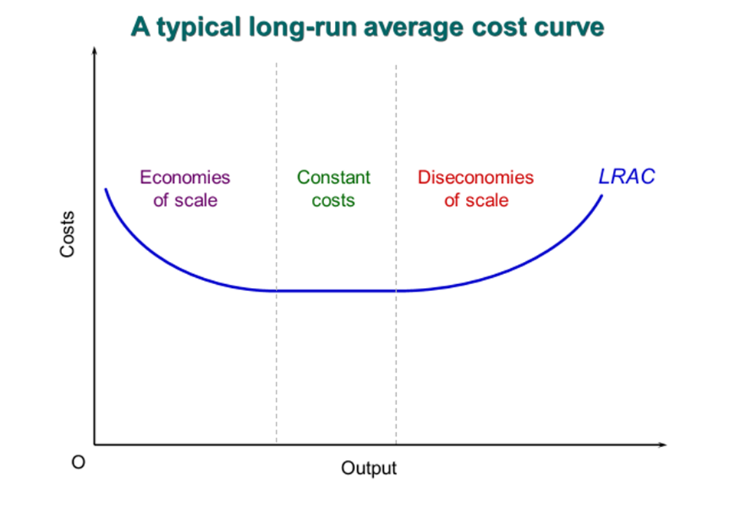
Costs in the Long run
When it comes to making long-run production decisions, the firm has much more flexibility.
It does not have to operate with plant and equipment of a fixed size – it can expand the whole scale of its operations.
All its inputs are variable
Since there are no fixed factors in the long run, there are no long-run fixed costs.
All costs in the long run, are variable costs.
Notes:
11

Slide 38
Summary
Utility is the satisfaction gained from consumption. Marginal utility diminishes as we increase consumption
Consumer surplus is the net gain from consumption
Risk exists in any event where the outcomes are unpredictable; there are 3 attitudes towards risk
A risk averse individual is willing to sacrifice some income to avoid risk; this individual can avoid risk by buying insurance
Insurance markets suffer from 2 problems i.e. adverse selection and moral hazard. Signalling/screening helps to resolve adverse selection while monitoring the behaviour of insurance buyers could reduce moral hazard
In the short-run, at least one factor of production is fixed.
The Law of Diminishing Returns is when each extra unit of the variable factor will produce less additional output than the previous unit.
A firm’s cost of production will depend on the productivity and costs of the factor of production it uses.
In the long-run, all factors of production are variable.
A firm experiences economies of scale if costs per unit of output fall as the scale of production increases

